Slide 1
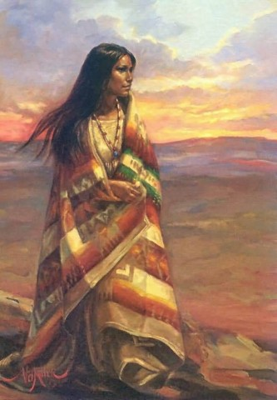
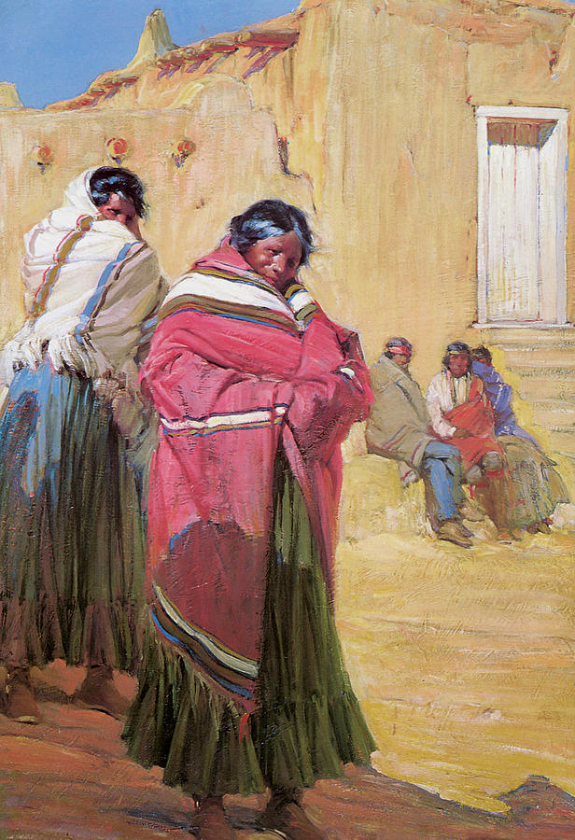
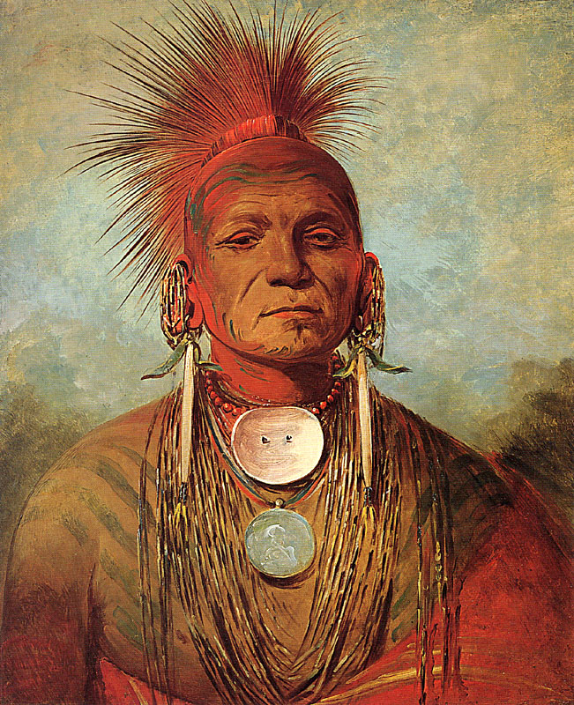
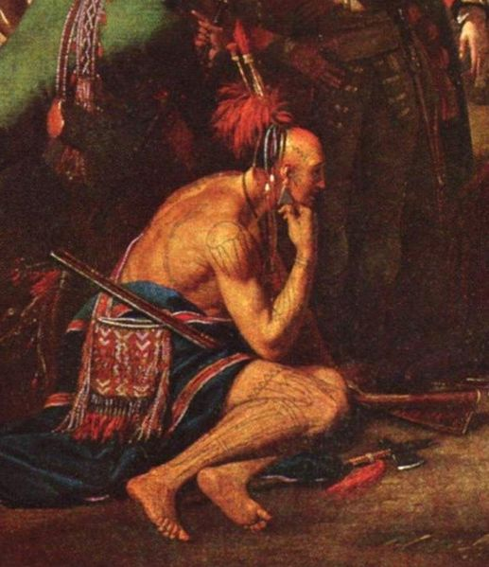
European Colonization in North America: Spanish, French, Dutch, & British Colonies
(Unit I, Segment 1 of 5)

Slide 2
Essential Questions:
Who lived in the Americas before 1492?
What are the similarities & differences among the Spanish, French, Dutch, & British patterns of colonization in America?

Slide 3
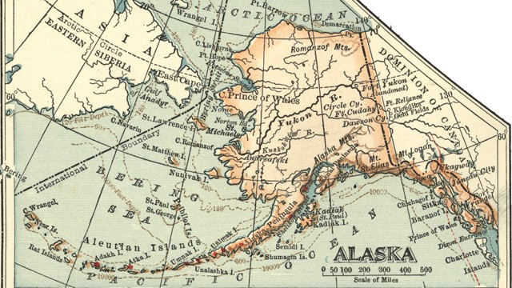
How did the first people come to North America???
Asian Migration to America
Asian peoples migrated from Siberia (Russia) across Bering Strait to Alaska (U.S.)
- Paleo-Indians
-15,000 - 30,000 years ago
-hunter-gathers to agriculture (villages)

Slide 4
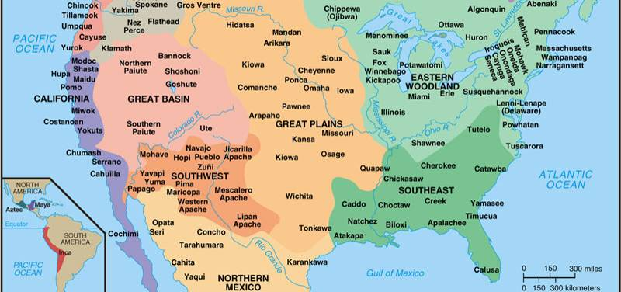
Before Columbus’ explored America in 1492, North America was dominated North American Indians:
America Before the Europeans
Before Columbus’ explored America in 1492, North America was dominated North American Indians:

Slide 5
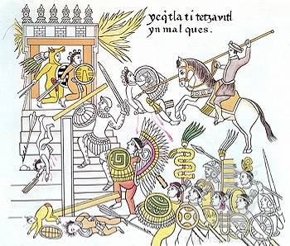
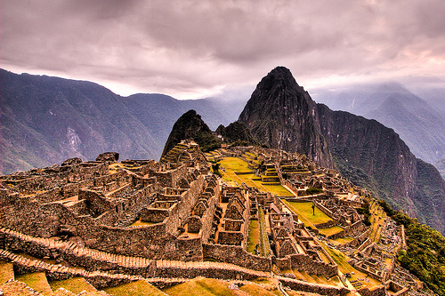
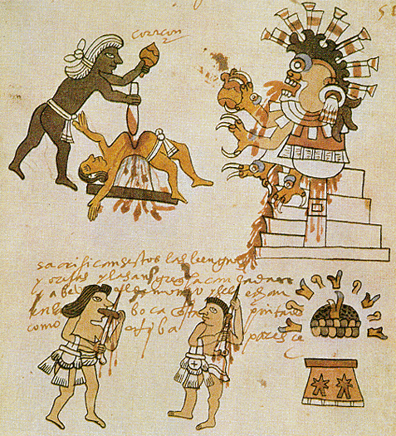
The Aztecs (in Central America) & Incas (in South America) created large, powerful empires
These empires were destroyed by the arrival of Spanish conquistadors

Slide 6
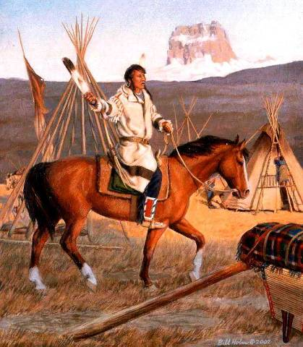
The Plains Indians were hunters & gathers but became mobile hunters after the Spanish introduced the horse into North America

Slide 7
The Eastern Woodlands Indians lived in small farming communities & were the first contacts with British settlers in Virginia & Massachusetts

Slide 8
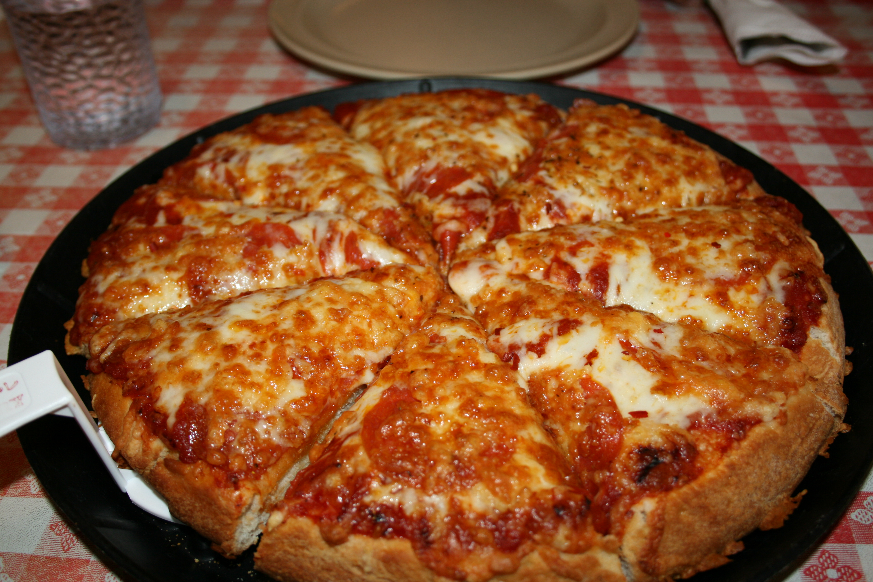
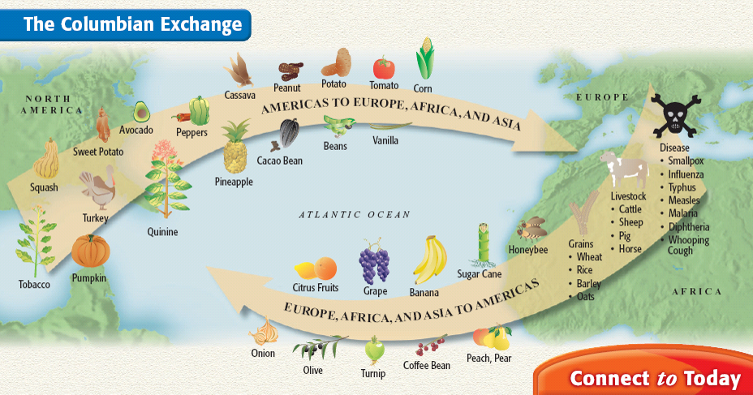
The arrival of Europeans led to the introduction of new products between North American Indians & Europeans called the Columbian Exchange:
N-A Indians introduced corn, tobacco, potatoes, peanuts to Europeans
Europeans introduced horses, livestock, citrus, & diseases
An estimated 90% of Native Americans died due to European disease

Slide 9
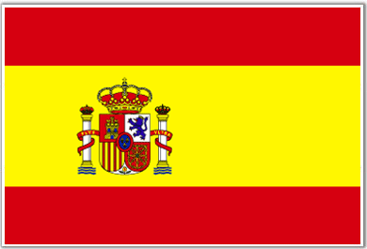
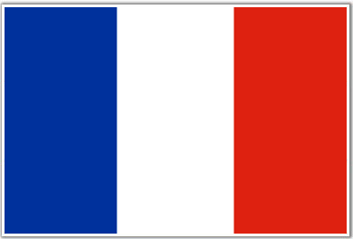
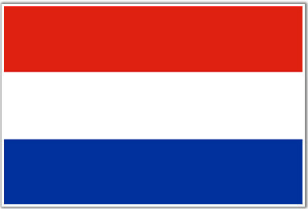
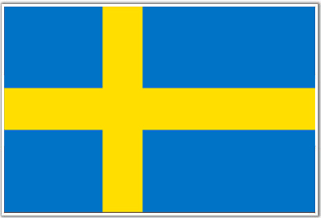
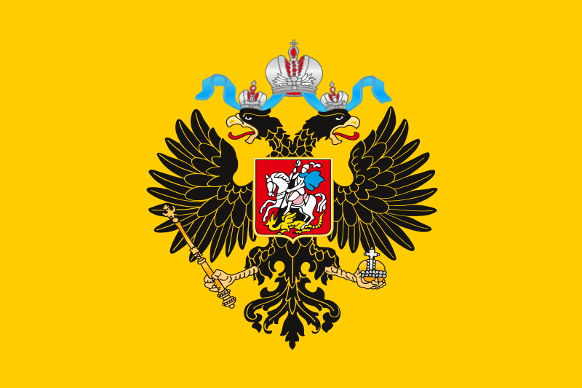
The European Colonies in America: Spain, France, the Netherlands, & Great Britain
Spain
Fleur de lys
France
Great Britain
Netherlands
Czar Russia
Sweden

Slide 10
The Renaissance and the Age of Exploration
Spain
During the Renaissance, a desire for new trade routes to Asia led to an Age of Exploration:
Led by Spain & Portugal, explorers found new trade routes, colonies, & people to Christianize
Colonization in North America led to destruction of Native American culture, permanent settlements for Europeans, & wealth for these nations
Fleur de lys
France
Great Britain
Netherlands
Czar Russia
Sweden

Slide 11
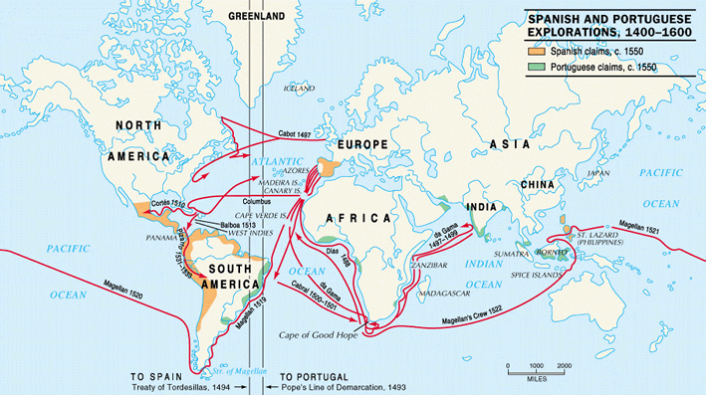
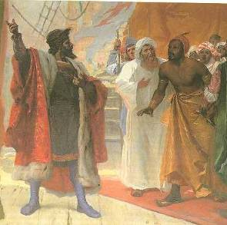
Four Key Explorers
Vasco da Gama “found” India by sailing around Africa

Slide 12
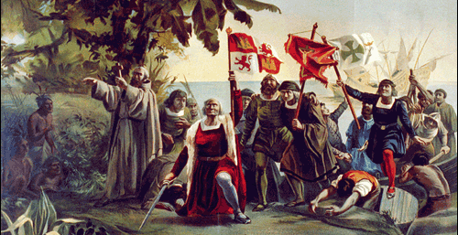
Four Key Explorers
Christopher Columbus “discovered” America looking for a westward route to India

Slide 13
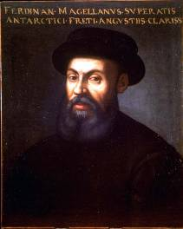
Four Key Explorers
Ferdinand Magellan led the first expedition to circumnavigate the globe

Slide 14
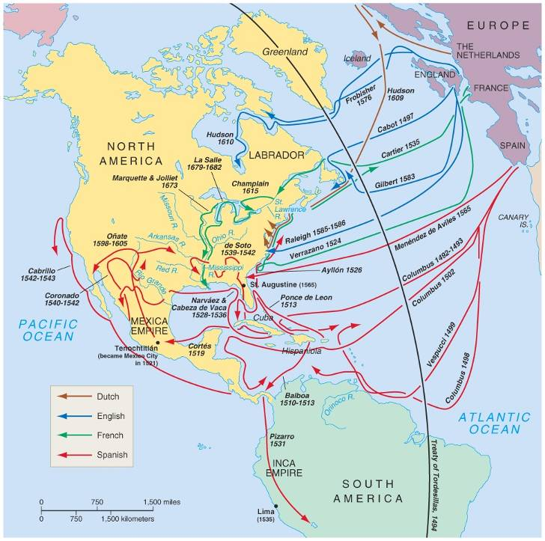
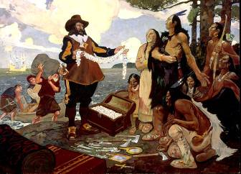
Four Key Explorers
Samuel Champlain founded Québec after failing to find a NW passage to India

Slide 15
Exploration led to permanent European colonies
Spain
Fleur de lys
France
Great Britain
Netherlands
Czar Russia
Sweden

Slide 16
Your task today is to figure out why the Spanish, French, Dutch,
& British colonies were founded & what they were like.

Slide 17
Colonial Settlement Group Activity
Spain
 Working in groups of 3, you will serve as historical anthropologists trying to find out about various European settlements
 Examine the various artifacts at each of the 9 settlement you visit & try to answer these questions:
Why was each settlement founded?
What was the economic & political system of each settlement?
How did they interact with the Native Americans?
What was important to each group?
Fleur de lys
France
Great Britain
Netherlands
Czar Russia
Sweden

Slide 18
Spain
Fleur de lys
France
Great Britain
Netherlands
Czar Russia
Sweden

Slide 19
Spanish Colonies in North America
Spain
Fleur de lys
France
Great Britain
Netherlands
Czar Russia
Sweden

Slide 20
Spanish Colonies in North America
Motivations:
After Columbus, Spain dominated Central & South America & the SE & SW sections of North America
Spanish conquistadors explored in search of gold & silver
Missionaries converted Native Americans to Catholicism
Spain
Fleur de lys
France
Great Britain
Netherlands
Czar Russia
Sweden

Slide 21
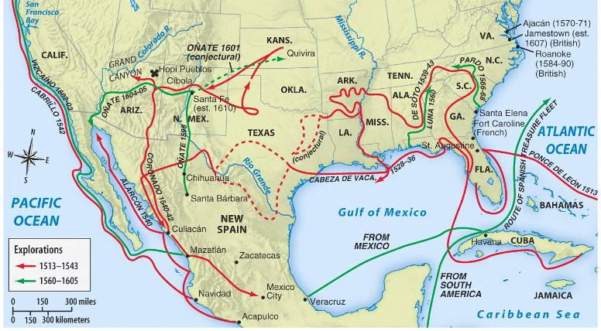
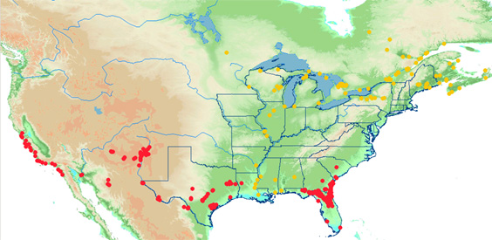
The Spanish government encouraged converting Native Americans & establishing missions

Slide 22
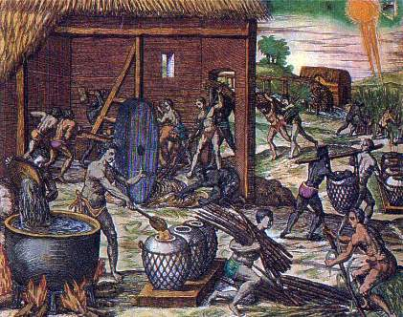
Spanish Colonies in North America
Government: Royal control
Spanish colonies were funded & controlled by the monarch
Viceroys were sent to the colonies to serve as governors
Economy: Desire for wealth
Used Native American & African slave labor to mine gold & silver
Built encomiendas (plantations) to farm cash crops
Spain
Fleur de lys
France
Great Britain
Netherlands
Czar Russia
Sweden

Slide 23
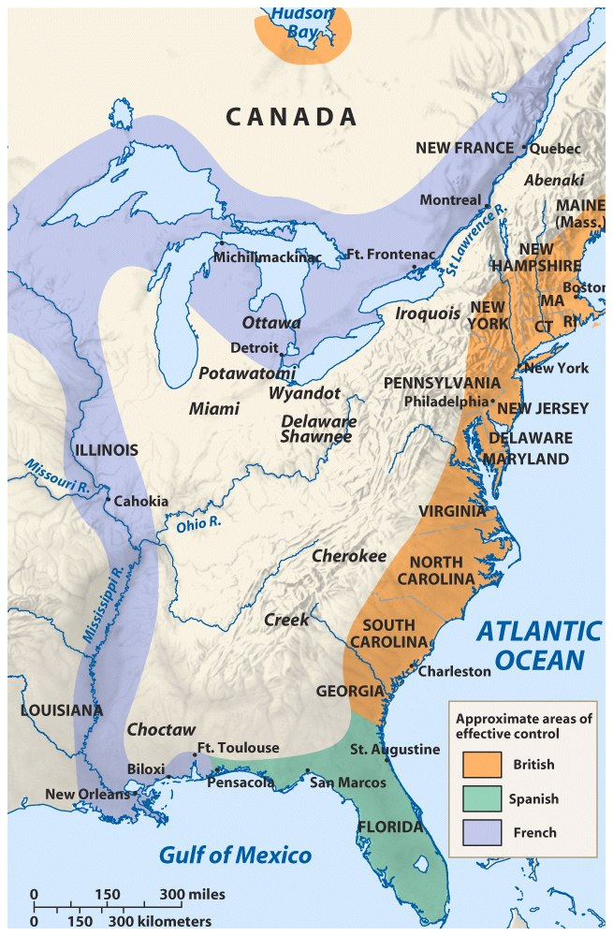
French Colonies in North America
Spain
Fleur de lys
France
Great Britain
Netherlands
Czar Russia
Sweden

Slide 24
French Colonies in North America
Motivations:
After Champlain’s attempt to find a NW passage through Canada, he founded Québec
The “French crescent” included Canada, the Mississippi River, & New Orleans
Missionaries converted Native Americans to Catholicism
Spain
Fleur de lys
France
Great Britain
Netherlands
Czar Russia
Sweden

Slide 25
Like Spain, the French gov’t encouraged converting Native Americans & establishing missions

Slide 26
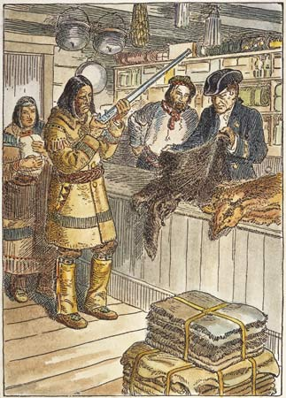
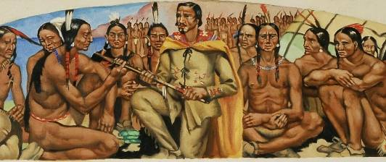
French Colonies in North America
Government:
The French colonies were strictly controlled by royal governors
Economy: Desire for fur trade;
Most French colonists profited from the fur trade, small-scale farming, or lumbering
Society: Because the French needed furs, they were the most friendly with the local Native Americans
Spain
Fleur de lys
France
Great Britain
Netherlands
Czar Russia
Sweden

Slide 27
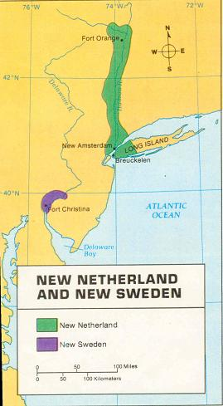
Dutch Colonies in North America
Spain
Fleur de lys
France
Great Britain
Netherlands
Czar Russia
Sweden

Slide 28
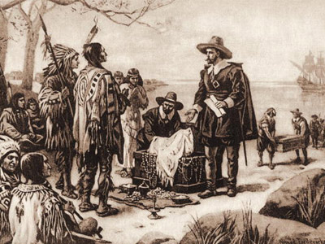
Dutch Colonies in North America
Motivations:
The Dutch established New Amsterdam as a trade center
Political, Economic, Social:
To attract settlers, the gov’t allowed anyone to immigrate
As a result, New Amsterdam was one of the most diverse colonies in North America
Spain
Fleur de lys
France
Great Britain
Netherlands
Czar Russia
Sweden

Slide 29
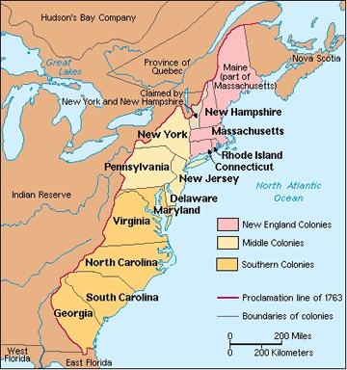
British Colonies in North America
Spain
Fleur de lys
France
Great Britain
Netherlands
Czar Russia
Sweden

Slide 30
British Colonies in North America
Motivations: Many different reasons
Economic: Escape poverty or gain wealth from cash crop farming
Religious: For religious freedom & to escape religious persecution
Political: Fear during the English Civil War & Glorious Revolution
As a result, the British colonies were very different from each other & were never very unified
Spain
Fleur de lys
France
Great Britain
Netherlands
Czar Russia
Sweden

Slide 31
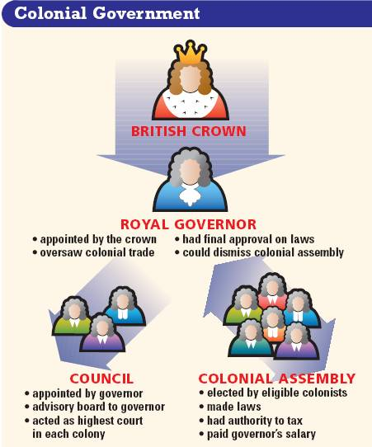
British Colonies in North America
Government:
The colonies differed from the French & Spanish because the British gov’t had no desire to create a centralized empire in America
Britain developed a policy called salutary neglect in which the colonists could create local laws & taxes in their colonial assemblies
Royal governors were sent by the king, but they had little power
Spain
Fleur de lys
France
Great Britain
Netherlands
Czar Russia
Sweden

Slide 32
British Colonies in North America
Economy & Society:
The societies & economies of the British colonies were dependent upon the reasons people settled
Spain
Fleur de lys
France
Great Britain
Netherlands
Czar Russia
Sweden

Slide 33
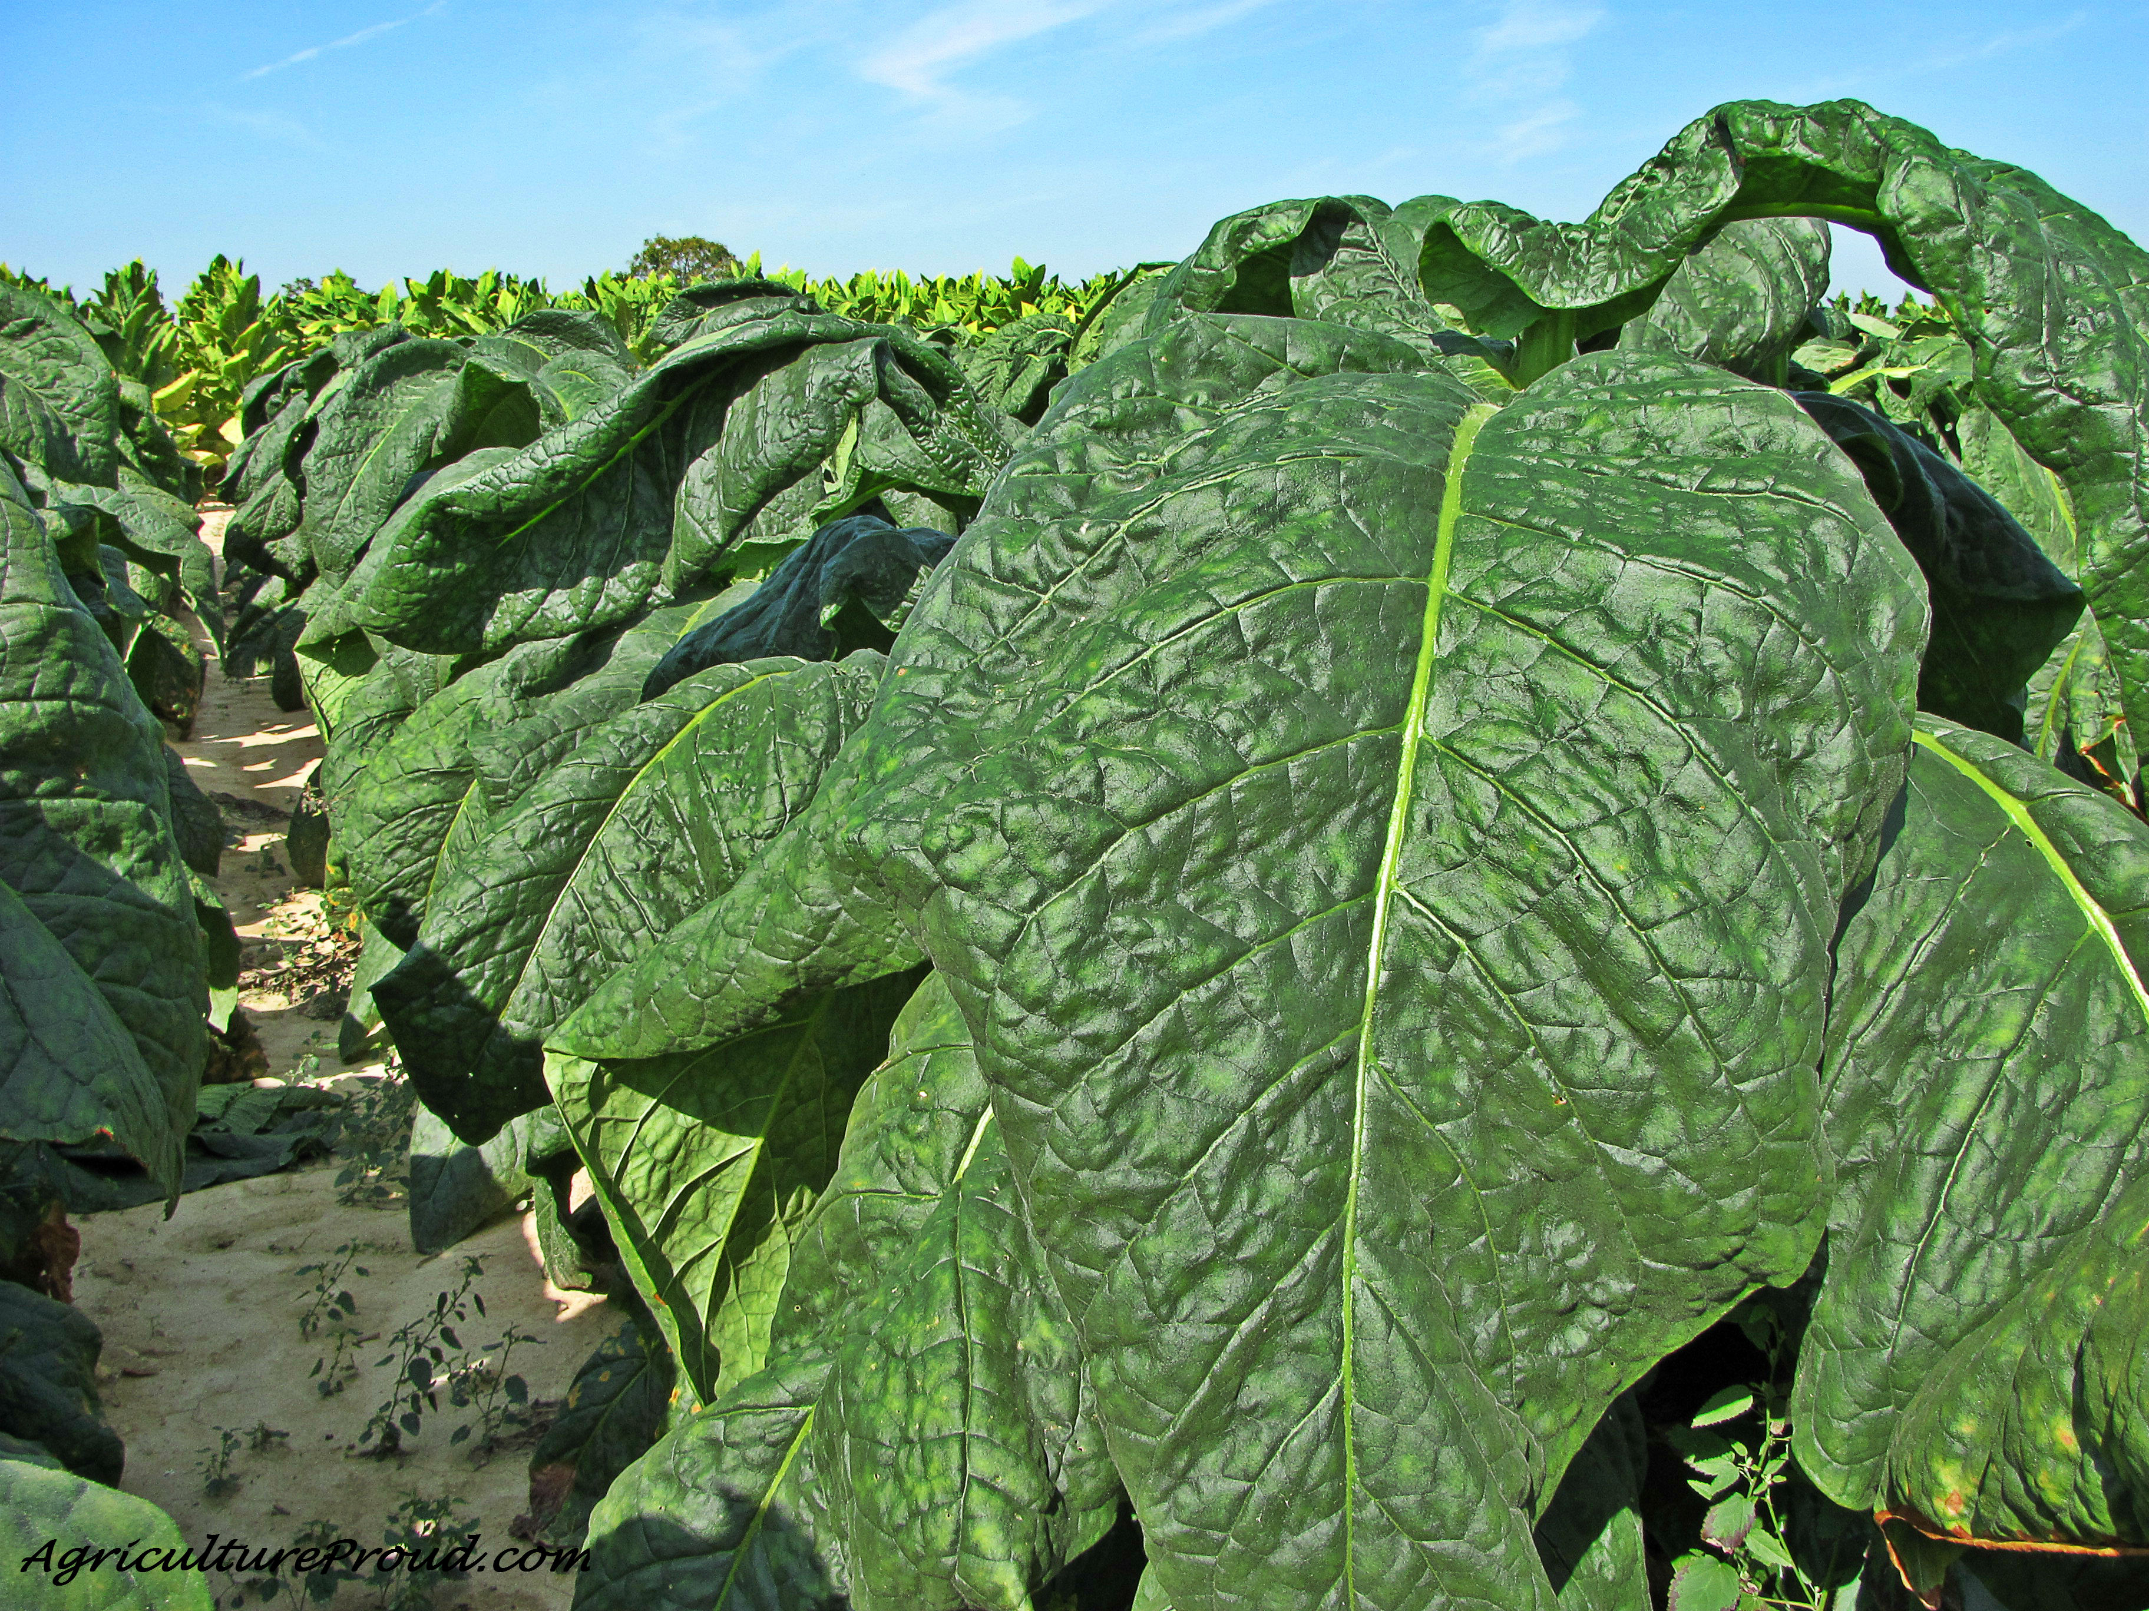
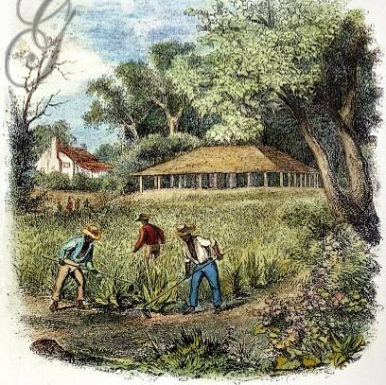
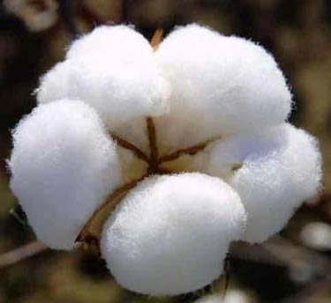
British Colonies in North America
Southern colonies, like Virginia, had cash crop economies, large gaps between rich & poor farmers, & slave labor
Spain
Fleur de lys
France
Great Britain
Netherlands
Czar Russia
Sweden

Slide 34
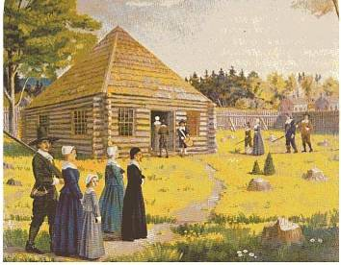
British Colonies in North America
New England colonies, like Massachusetts, were closely connected by religion & families & were mostly subsistence farmers
Spain
Fleur de lys
France
Great Britain
Netherlands
Czar Russia
Sweden

Slide 35
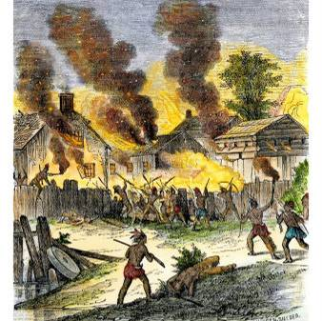
British Colonies in North America
Unlike the Spanish & French, the British colonists never made sweeping attempts to convert, marry, or trade with local Native Americans, although conflicts over land were common
Spain
Fleur de lys
France
Great Britain
Netherlands
Czar Russia
Sweden

Slide 36
Closure Activity
In order to review the Spanish, French, Dutch, & British colonies, students will be presented with a series of “potential immigrants” to North America. For each person:
Determine the best colonial region for that person to move into
Provide a brief explanation that supports your decision
Spain
Fleur de lys
France
Great Britain
Netherlands
Czar Russia
Sweden

Slide 37
(1) Potential Immigrant: A person with
very religious beliefs
(S) Spain (D) Dutch
(F) France (B) Britain
Why?
Spain
Fleur de lys
France
Great Britain
Netherlands
Czar Russia
Sweden

Slide 38
(2) Potential Immigrant: A poor, unmarried man looking to make his fortune
(S) Spain (D) Dutch
(F) France (B) Britain
Why?
Spain
Fleur de lys
France
Great Britain
Netherlands
Czar Russia
Sweden

Slide 39
(3) Potential Immigrant: A woman looking for new opportunities in America
(S) Spain (D) Dutch
(F) France (B) Britain
Why?
Spain
Fleur de lys
France
Great Britain
Netherlands
Czar Russia
Sweden

Slide 40
(4) Potential Immigrant: A person looking for political freedom & the ability help make laws
(S) Spain (D) Dutch
(F) France (B) Britain
Why?
Spain
Fleur de lys
France
Great Britain
Netherlands
Czar Russia
Sweden

Slide 41
(5) Potential Immigrant: A Native American looking for freedom from European control
(S) Spain (D) Dutch
(F) France (B) Britain
Why?
Spain
Fleur de lys
France
Great Britain
Netherlands
Czar Russia
Sweden

Slide 42
(6) Potential Immigrant: A person who enjoys living “where the action is” (a place where
something exciting is always happening)
(S) Spain (D) Dutch
(F) France (B) Britain
Why?
Spain
Fleur de lys
France
Great Britain
Netherlands
Czar Russia
Sweden

Slide 43
(7) Potential Immigrant: A father looking for safety & security for his family
(S) Spain (D) Dutch
(F) France (B) Britain
Why?
Spain
Fleur de lys
France
Great Britain
Netherlands
Czar Russia
Sweden

Slide 44
(8) Potential Immigrant: An entrepreneur looking for a location to open a business specializing in shipping
(S) Spain (D) Dutch
(F) France (B) Britain
Why?
Spain
Fleur de lys
France
Great Britain
Netherlands
Czar Russia
Sweden

